Slide 1



DWI Detection & SFST
Instructor
Development
Course
Session 4 – SFST Curriculum Package and
Teaching Assignments
February, 2017

Slide 2

Content Segments
SFST Curriculum Package
Overview of the SFST School
Purpose of the Lesson Plans
How to Use the Lesson Plans
Outlines
Teaching Assignments
Questions and/or Concerns
Notes:
Session 4: SFST Curriculum Package and Teaching Assignments
Estimated time for Session 4: 2 Hours (depending on class size)
Session Objectives
Describe the documents that make up a standard curriculum package
Describe the content and format of the lesson plans in the SFST School
Contents
SFST Curriculum Package
Overview of the SFST School
Purpose of the Lesson Plans
How to Use the Lesson Plans
Outlines
Teaching Assignments
Questions and/or Concerns
Materials
Presentation Slides
Easel/Easel Pad
Markers
SFST Instructor Guide
Teaching Assignments
Student-Instructor Critique Forms
Instructional Notes are presented in bold italic throughout the sessions.

Slide 3

DWI Detection and SFST
Instructor Development Course
Session 4:
SFST Curriculum Package
And Teaching Assignments
Notes:
Session 4: SFST Curriculum Package and Teaching Assignments
Estimated time for Session 4: 2 Hours
Materials:
Presentation Slides
Easel/Easel Pad
Markers
SFST Instructor Guide
Teaching Assignments
Student-Instructor Critique Forms
__________________________________________________________________________
__________________________________________________________________________
__________________________________________________________________________
__________________________________________________________________________
__________________________________________________________________________
__________________________________________________________________________
__________________________________________________________________________

Slide 4

Session Objectives
Describe documents that make up a standard curriculum package
Describe content and format of lesson plans in SFST School
Notes:
Session Objectives
At the conclusion of this session, participants should be able to:
Describe the documents that make up a standard curriculum package
Describe the content and format of the lesson plans in the SFST School
__________________________________________________________________________
__________________________________________________________________________
__________________________________________________________________________
__________________________________________________________________________
__________________________________________________________________________
__________________________________________________________________________
__________________________________________________________________________
__________________________________________________________________________
__________________________________________________________________________
__________________________________________________________________________

Slide 5

Notes:
SFST Curriculum Package
A complete curriculum, or course of instruction, has been prepared for SFST training.
The full course spans three full days.
First day is devoted primarily to the first two phases of DWI Detection
Second and Third days are mainly spent on the three Standardized Field Sobriety Tests
Mention it is possible to adapt the SFST curriculum to conduct a two-day course devoted exclusively to the SFSTs.
__________________________________________________________________________
__________________________________________________________________________
__________________________________________________________________________
__________________________________________________________________________
__________________________________________________________________________
__________________________________________________________________________
__________________________________________________________________________

Slide 6

Overview of the SFST School
For whom is the training intended
What is the purpose of the training
What will the participants get out of the training
Notes:
B. Overview of the SFST School
For whom is the SFST training intended? This training is intended for any police officer who is responsible for DWI enforcement, although other criminal justice professionals may also benefit from the training. (Refer to IACP International SFST Standards)
What is the purpose of the training? To increase arrests for DWI as a means of deterring DWI violators
What will the participants get out of the training? If the participants complete the SFST School successfully, they will better able to:
Detect evidence of impaired driving
Describe the evidence clearly and convincingly in written reports and in verbal testimony
_________________________________________________________________________________
_________________________________________________________________________________
_________________________________________________________________________________
_________________________________________________________________________________
_________________________________________________________________________________
_________________________________________________________________________________
_________________________________________________________________________________

Slide 7
Overview of the SFST School
What subject matter does the course cover
What activities take place during the training
How long does the training take
Notes:
What subject matter does the course cover?
Scope of the DWI problem
Concept of General Deterrence
DWI Legal Environment
Three Phases of DWI Detection
Clues of Impairment Associated with each Phase
Concepts and Principles of the SFSTs
Guidelines for Processing Suspects, Preparing Reports and Delivering Testimony
What activities take place during the training? The major learning activity in the SFST Course is hands-on practice
How long does the training take? You should not attempt to conduct a version shorter than two days and a two-day School should be devoted exclusively to the three tests. The ideal is a Three-day School.
_________________________________________________________________________________
_________________________________________________________________________________
_________________________________________________________________________________
_________________________________________________________________________________
_________________________________________________________________________________
_________________________________________________________________________________

Slide 8

Notes:
Point out an Instructor Guide has been prepared for the course.
The Instructor guide contains three things:
Administrator Guide
Lesson Plans
Visuals
_____________________________________________________________________________
_____________________________________________________________________________
_____________________________________________________________________________
_____________________________________________________________________________
_____________________________________________________________________________
_____________________________________________________________________________
_____________________________________________________________________________
_____________________________________________________________________________
_____________________________________________________________________________

Slide 9

Administrator Guide
Notes:
Note the first section of the Instructor Guide is the Administrator Guide.
The Administrator Guide is intended to provide an introduction to and an overview of the course.
The Administrator Guide begins with a section called “Purpose of this Document,” a brief description of the Guide
The next section, “Overview of this Course,” gives some very important information about what the SFST School covers and who should attend
The last section, “A Synopsis of the Curriculum,” gives a brief summary of the lesson plans and the visuals
As instructors, it is essential you be thoroughly familiar with the Administrator Guide.
Review “Guidelines for Controlled Drinking Practice Sessions” in the DWI Detection and SFST Administrator Guide, located in the SFST instructor guide for detailed instructions regarding conducting the alcohol workshop. This is further discussed in Session 10 of this curriculum, Planning & Managing a Live Alcohol Workshop.
_____________________________________________________________________________
_____________________________________________________________________________
_____________________________________________________________________________
_____________________________________________________________________________

Slide 10

Purpose of the Lesson Plan
Help you get ready to teach
Help you stay on track
Ensure consistency of training
Notes:
The second section (and the bulk) of the Instructor Guide are lesson plans.
C. Purpose of the Lesson Plans
Lesson plans have three main purposes.
1. Help you get ready to teach
Ensure you have all the needed materials and resources
Familiarize yourself with the lesson plans thoroughly before you attempt to teach a session
Ensure you understand what the participants should become able to do
Ensure you understand the information to present to the participants
Ensure you can perform the skills and procedures you are to demonstrate to the participants
2. Help you stay on track
Don’t try to memorize the lesson plans
Don’t be afraid to refer to the lesson plans while you are teaching; they are intended to help you
3. Ensure consistency of training
__________________________________________________________________________
__________________________________________________________________________

Slide 11
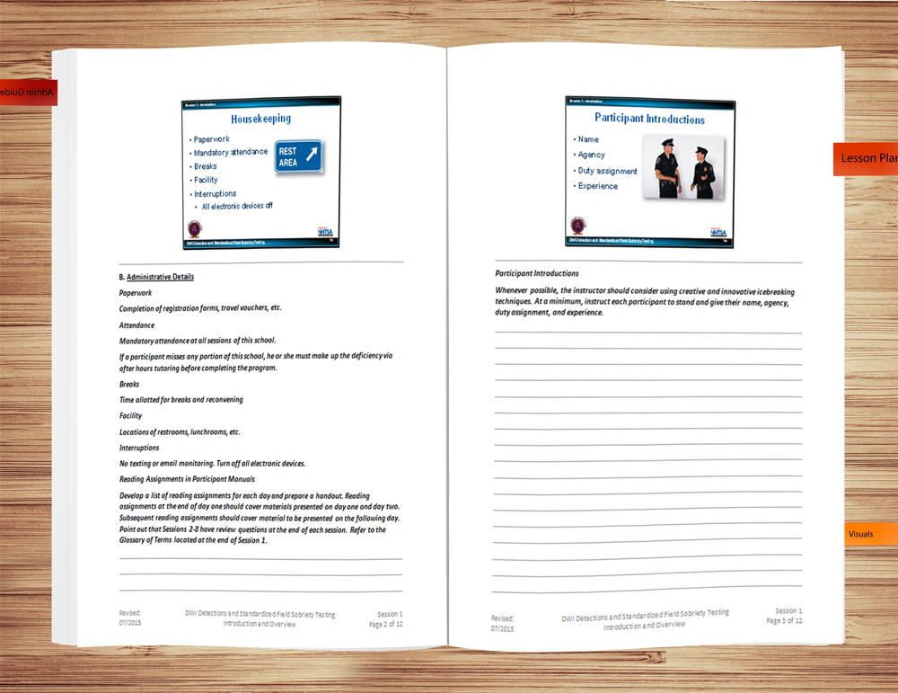
Format of the Lesson Plans
Notes:
Format of the Lesson Plans
The lesson plans for the SFST Course are organized on a session-by-session basis
There are 16 sessions in the SFST Curriculum
Each session has its own set of lesson plans
Session 1 is “Introduction and Overview”
The first page of each set of lesson plans is the cover page
The cover page gives the number and titles of the session and indicates the approximate amount of time the session requires
For example, Session 1 of the SFST Curriculum requires approximately 30 minutes
The second page of a set of lesson plans is the outline page
The outline page lists the learning objectives for the session, i.e., states what the participant will be able to do after successfully completing the session
The outline page also lists the content segments of the session which correspond to the major topics covered
Finally, the outline page indicates the major types of learning activities that take place during the session
The main purpose of the outline page is to help you prepare to teach
If you are assigned to begin teaching a session, you should start by reviewing the session’s objectives with the participants
Next, preview the content and the learning activities.

Slide 12

How to Use Lesson Plans
Notes:
D. How to Use THE Lesson PLans
Read the lesson plan
Personalize the lesson plan
Use the lesson plan to prepare
__________________________________________________________________________
__________________________________________________________________________
__________________________________________________________________________
__________________________________________________________________________
__________________________________________________________________________
__________________________________________________________________________
__________________________________________________________________________
__________________________________________________________________________
__________________________________________________________________________
__________________________________________________________________________
__________________________________________________________________________

Slide 13
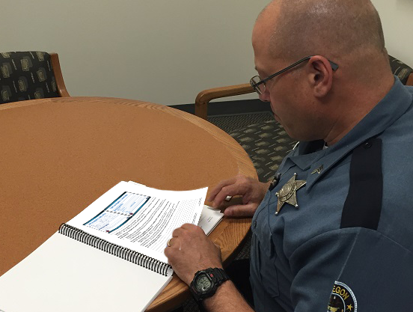
Read the Lesson Plan
Notes:
Read the Lesson Plan
Begin by reading not only the portion you have been assigned to present, but the entire curriculum. You will need to become familiar with the content materials as well as understand where and how it fits in the course.
If you do not understand the material, you may need to research other written material or talk with another instructor familiar with the subject matter
__________________________________________________________________________
__________________________________________________________________________
__________________________________________________________________________
__________________________________________________________________________
__________________________________________________________________________
__________________________________________________________________________
__________________________________________________________________________
__________________________________________________________________________
__________________________________________________________________________
__________________________________________________________________________

Slide 14

Personalize
Notes:
Personalize
The instructional notes area of the lesson plan can be used to insert your own examples relevant to the material being taught. This is also where you can note the prepared questions to ask the class. Personal experiences add impact and increase retention of content material. Adding our own examples incorporates our own personality and style to the training delivery.
The lesson plan should have your own notes and questions incorporated in the instructional notes. Make sure you know how the slides read and when they are to be used. You should also have any other training aids such as props, etc., available for you to practice using. If you plan to use prepared easel/easel pads, this is when you will need to prepare them.
__________________________________________________________________________
__________________________________________________________________________
__________________________________________________________________________
__________________________________________________________________________
__________________________________________________________________________
__________________________________________________________________________
__________________________________________________________________________

Slide 15
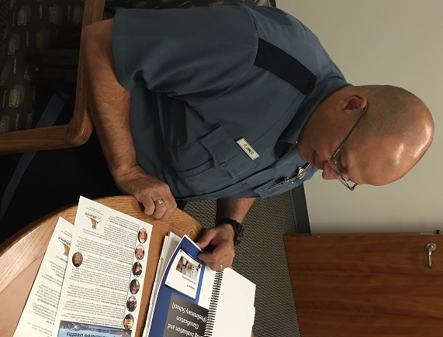
Prepare
Notes:
Preparation
Start by going through the material just as you would during the presentation, don't try to memorize it
Some trainers use the "3 to 1" ratio for determining how much time to prepare. This formula means for every hour of instruction, we would need to prepare for three hours. However, remember subject matter knowledge, experience in training others, and individual confidence levels will also influence the amount of preparation time required.
If possible, practice presenting aloud in the room you will actually be using. This will help you feel more comfortable and familiar with the surroundings. You will also look as if you are used to moving around in that environment.
If possible, record your practice presentations on video to enable you to see and hear yourself as the participants will. However, because this is not always possible, the next best-practice technique is to audio record your presentation.
Here are just some of the advantages of recording yourself:
Check voice tone and rate of speech
Improve word enunciation
Substitute words that are awkward or difficult to pronounce
Listen to how we phrase questions and give feedback to responses
Practice responding to questions that might be asked
Listen for fillers such as "uh's," "and uh," "O.K.," etc.
__________________________________________________________________________
__________________________________________________________________________

Slide 16

Outlines
Notes:
E. Outlines
Content Outline
Describes what is included
List of facts to be presented
Outline of procedures to be demonstrated
Details on concepts to be explained
Series of ideas to be discussed
Delivery Method Outline
Describes how the content is presented
Amount of time to be spent on the topic
Audio-visual aids to be used
Questions to be posed to stimulate participation
Procedures for classroom learning activities
Indications of points to be emphasized
__________________________________________________________________________
__________________________________________________________________________
__________________________________________________________________________

Slide 17

What to Take to the Classroom
Lesson Plans
PowerPoint Slides
Training Props or Demonstration Materials
Reference Materials
Notes:
What to Take to the Classroom
Lesson Plan
PowerPoint Slides
Training props or demonstration materials
Any other reference materials or notes you will be using during your presentation of the material
Trainers should incorporate their individual style into the delivery.
While not all of the techniques we see used by other instructors may seem comfortable for us, we should try to find ways to enrich the learning experience for our participants. Their needs, after all, are why we conduct training.
Techniques or methods which reinforce learning of new information or improve retention should be an integral part of training delivery, not the exception.
__________________________________________________________________________
__________________________________________________________________________
__________________________________________________________________________
__________________________________________________________________________
__________________________________________________________________________

Slide 18

Notes:
Small Group Curriculum Activity
Divide class into 4 groups:
SFST Instructor Guide Administrator Guide group
SFST Instructor Guide Sessions 1-5 group
SFST Instructor Guide Session 6-10 group
SFST Instructor Guide Session 11-15 group
Each group will be given 15 minutes to research their topic.
Each group will present to the class the relevant information of their topic (maximum 15 minutes per group).
Key points to be elicited from the Administrator Guide group
For whom is the SFST course intended
How long is the training
Classroom requirements
Materials needed
Alcohol workshop information
Video options information
Requirements to pass the course
Key points to be elicited from the three instructor guide groups
This information can be located in the Appendices of the DWI Detection and SFST course Administrator Guide

Slide 19
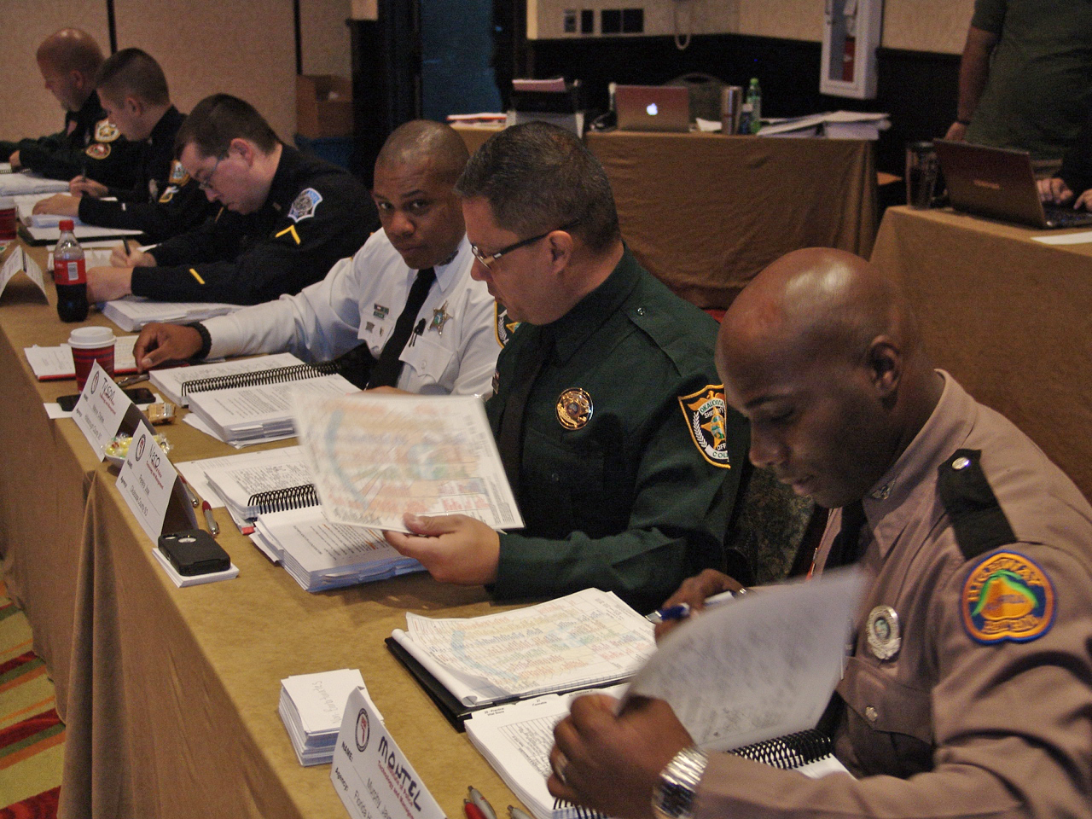
Teaching Assignments
Notes:
F. TEACHING ASSIGNMENTS
Identification Of Teaching Assignments – Hand out Student-Instructor Assignment Sheet located in the Appendices.
Discuss classroom assignments (Classroom A, B, C, etc.). Student instructors will work in a particular classroom for all teaching assignments. Inform the participants of the locations of the various classrooms. Each classroom will be fully equipped with audio-visuals, participant handout materials, etc.
Discuss sessions and segments. Each student-instructor has one or more teaching assignments. Instruct the participants to identify their personal assignments and to “highlight” those Sessions and Segments using a yellow marker.
All assignments are team-teaching assignments. Participants must get together with their partners to decide how they will “divide up” the teaching responsibilities for each Session and Segment.
Supply participants with the presentation evaluation forms containing the performance indicators that will be evaluated (See Appendices in Administrator Guide).
Repeat repetition exercise from Session 3E
Allow participants to spend balance of day in individual reviews of their assigned lesson plans. “Visit” participants to verify they understand their assignments. Encourage participants to ask questions to remove any confusion they may have about the lesson plans.
Instruct the participants to meet with their team-teaching partner and begin “dividing up” their assignments.

Slide 20

Questions and/or Concerns
Notes:
G. QuestionS AND/OR CONCERNS
Solicit questions and comments from participants before moving to the next Session.
__________________________________________________________________________
__________________________________________________________________________
__________________________________________________________________________
__________________________________________________________________________
__________________________________________________________________________
__________________________________________________________________________
__________________________________________________________________________
__________________________________________________________________________
__________________________________________________________________________
__________________________________________________________________________
__________________________________________________________________________

